Slide 1
Biobanks and the Ethics Committee
Aernout De Raemaeker
Legal Advisor - Clinical Trial Center UZ Leuven
30/10/2020

Slide 2
Overview
Legislation HBM for research
Notification FAMHP and Positive Opinion EC
Initial Evaluation
Biennial Evaluation

Slide 3
Legislation HBM for research
19 December 2008 – Law concerning the obtaining and use of human body material (HBM) for medical application on humans or scientific research (“HBM Law”)
Royal Decree of 9 January 2018 concerning the biobanks (“RDBB”)

Slide 4
Notification biobank (FAMHP) – art. 3 RDBB
Response FAMHP within 15 days
Incomplete: 15 days to complete
Complete: biobank receives notification number
No response FAMHP within 15 days = notified

Slide 5
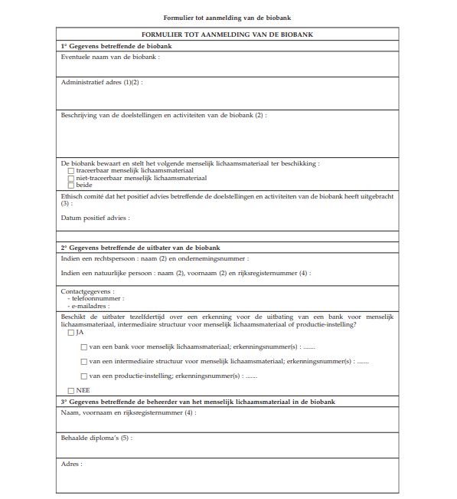
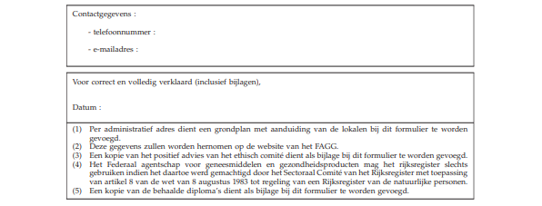
Notification Biobank (FAMHP)

Slide 6
Positive Opinion EC
Prior to notification to FAMHP (admissibility condition for notification)
Article 22 §1 HBM Law
Competent EC?
fully recognized EC in accordance with Law 7 May 2004 concerning experiments on the human person
What?
Positive opinion on aims, objectives and activities

Slide 7
Aims/objectives and activities
Aims/objectives
Scope: research domains/types of research
Activities
Definition “biobank”: the structure which, for the purposes of scientific research, with the exception of research with human medical applications, obtains, when appropriate treats, stores and makes available human body material, as well as, human body and donor data if the opportunity arises (Art. 2, 27° HBM Law)
Biobank performs either one or more of these activities

Slide 8
Initial evaluation EC
Information/Documents/SOPs to safeguard operability/compliance with applicable law, e.g.:
Collection HBM (art. 2 RDBB)
Traceable HBM
Biobank manager qualification (art. 22 §3 HBM Law)
Donor identification system (art. 8 RDBB)
Coding HBM (art. 22 §5 HBM)
Continuity traceability (art. 22 §5 HBM Law)
Meaningul information health donor (art. 11 HBM Law + artikel 7, §§ 2, 3 and 4 Law 22 August 2002 concerning right of the patient)
Lifting traceability (art. 22 §7 HBM Law)
Registry (art. 9 RDBB + art. 22 §2 HBM Law)
Template agreement/framework agreement (art. 10 RDBB + art. 22 §2 HBM Law)
Evaluation procedure consent/opt-out (art. 11 RDBB)
Preservation personal data (art. 22 §8 HBM Law)
Termination activities biobank (art. 17 §§1/1, 2 and 3 HBM Law)

Slide 9
Biennual evaluation EC (art. 6-7 RDBB)
Once every two years
Activities and aims/objectives biobank
Overview HBM stored and/or made available + destination (registry)
Modification aims, objectives and activities (art.4 RDBB) => implications for aims, objectives and activities

Slide 10
Biennual evaluation EC
Activities not in accordance with positive opinion EC
EC: provides draft decision alteration or withdrawal opinion
Biobank: propose arguments + corrective measures (within 1 month)
EC: motivated final decision (within 1 month or reinitiate procedure)
Biobank: conform within reasonable term
EC: report alteration or withdrawal to FAMHP

